Slide 1
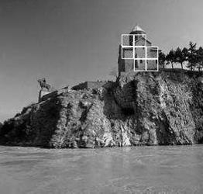
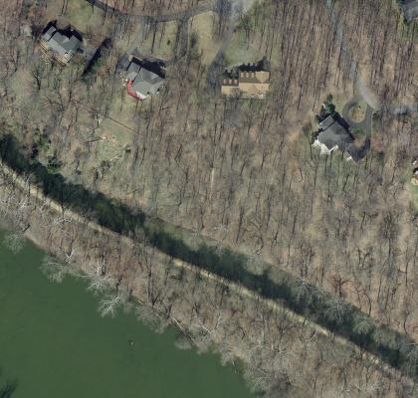
Discriminative Random Fields: An Implementation for Aerial Structure Detection Dan Denton Jesse Selover
Problem: We intend to replicate the results of Kumar and Hebert [1] using aerial orthophotos.
Method: Discriminative Random Fields [1], which extend the work of Lafferty et al. on Conditional Random Fields [2], have been achieved great results.
Data: We will use photos from the Montgomery County, MD Online Digital Aerial Photo Archive [3].
[1]
References:
[1] S. Kumer and M. Hebert. Discriminative random fields. International Journal of Computer Vision, 68(2):179-202, 2006.
[2] J. Lafferty, A. McCallum, and F. Pereira. Conditional random fields: probabilistic models for segmenting and labeling sequence data. In IMCL, 282-289. 2001.
[3] Montgomery County Maryland GIS, April 2012
[3]

